Slide 1
Hotel Room
Booking Management System
www.collaberadigital.com

Slide 2
Personal BACKGROUND
(Name, Past Experience, Qualification, Career Summary)
Name : Mark Christian L. Balagot
Past Experience : IT Intern in Dymos Systems Inc.
React Web Developer
Qualification : Bachelor of Science in Computer (Graduated 2022), TUP-Manila

Slide 3
Personal BACKGROUND
(Name, Past Experience, Qualification, Career Summary)
Name : Ivhan Patrick D. De Leon
Past Experience : Freelancing (vb.net) Windows Applications and UI
Qualification : Bachelor of Science in Computer Engineering Graduated (2022)

Slide 4
Key Takeaways/Learnings from the Program (HTD)
.Net Core MVC Web Application
.Net Core Web API with Entity Framework in ASP.NET Core Web Applications and Web API
ASP.NET CORE Identity Entity Framework Core
Application Deployment using Docker and Kubernetes

Slide 5
Problem Statement of the Capstone Project
Rapid growth in the number of customers seeking accommodation services
Existing manual system is becoming inefficient, cumbersome, and time-consuming
Lots of errors, double bookings, and customer dissatisfaction
Need for a web-based hotel room booking application
Provides a reliable and user-friendly platform for customers
Enables easy and efficient searching, booking, and managing of hotel reservations

Slide 6
Approach Note
(How the candidate approached the program)
Starting from developing of the system, we start by creating Business Requirements Documentation to support the systems functionality and requirements.
Usage of Drawi.io for creating the Entity Relationship Diagram and Wireframe of the application
Development of the application using ASP.Net Core MVC
Development of Web API
Deployment of the Application using Docker and Kubernets

Slide 7
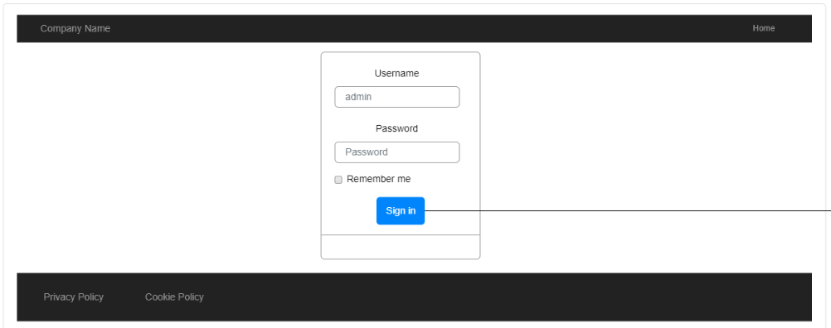
Wireframes

Slide 8
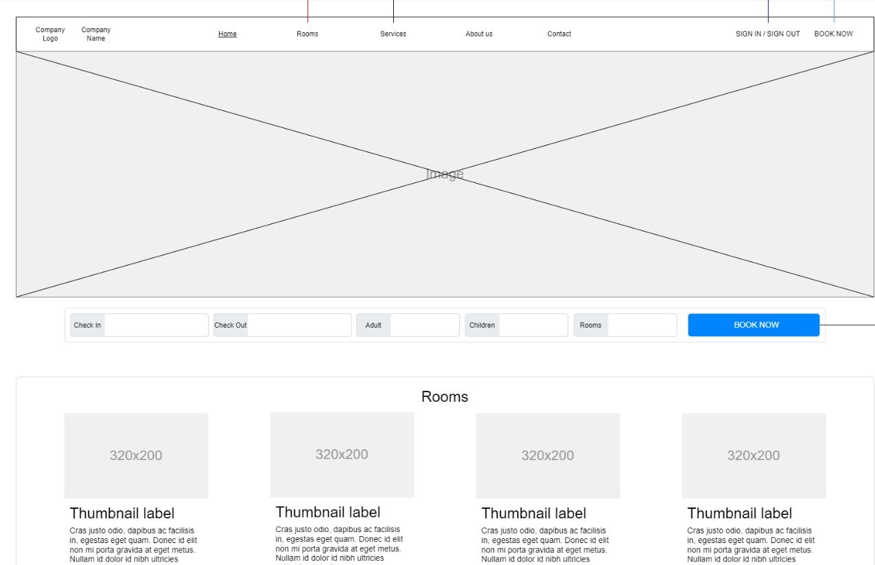
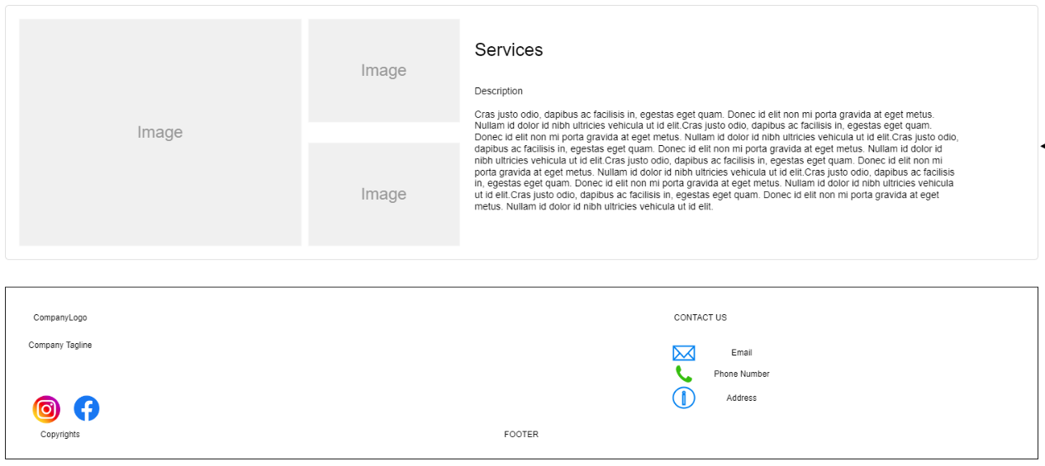
Wireframes

Slide 9
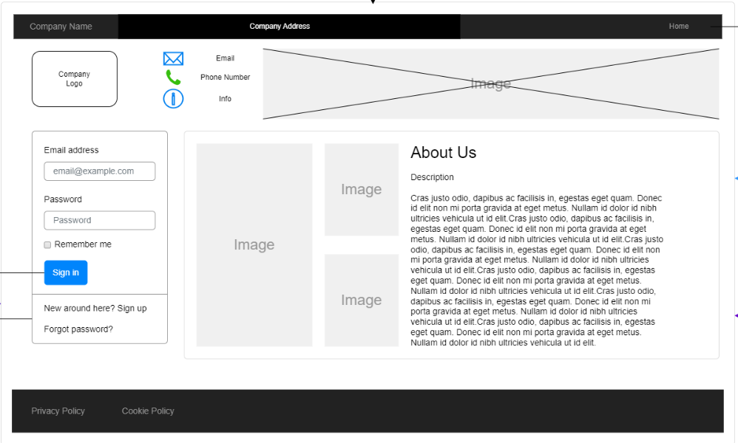
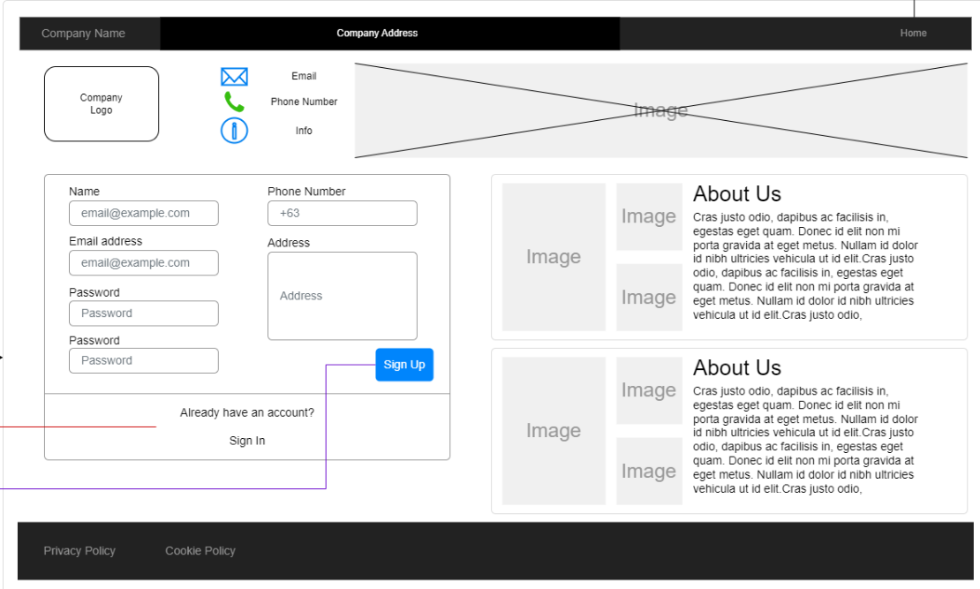
Wireframes

Slide 10
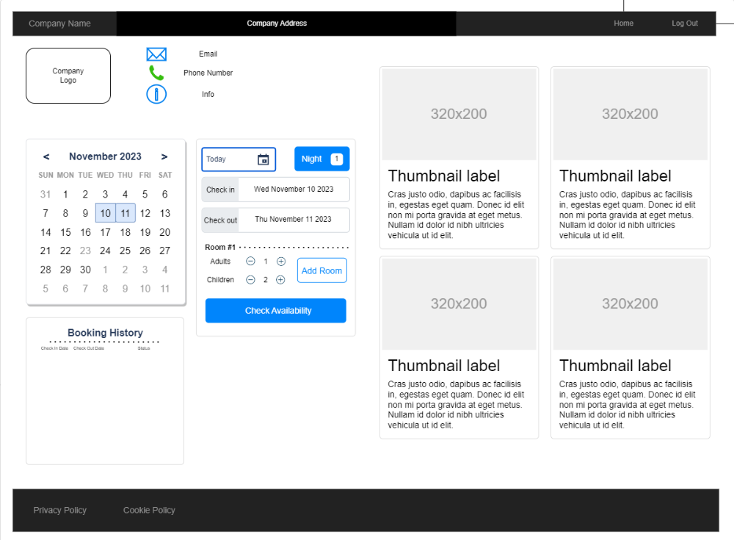
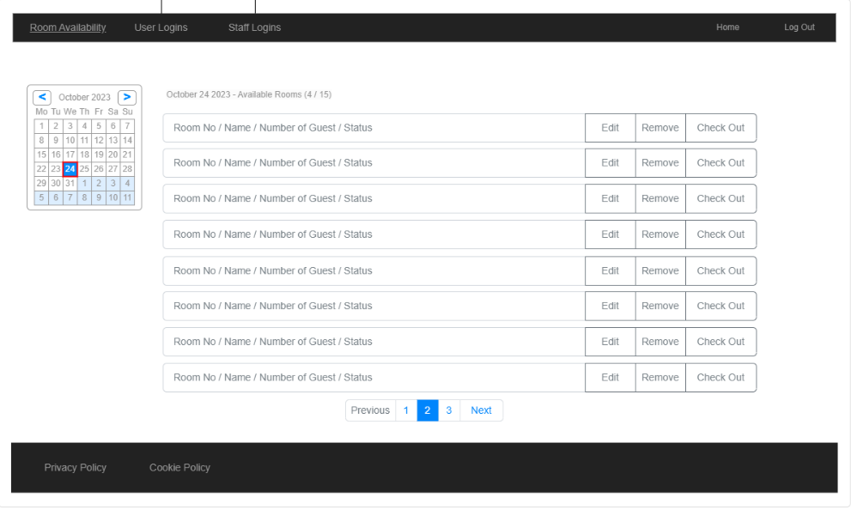
Wireframes

Slide 11
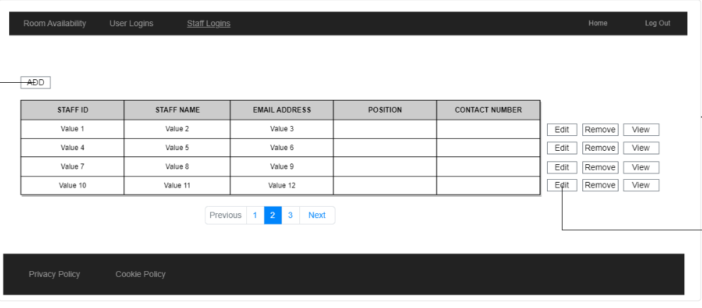
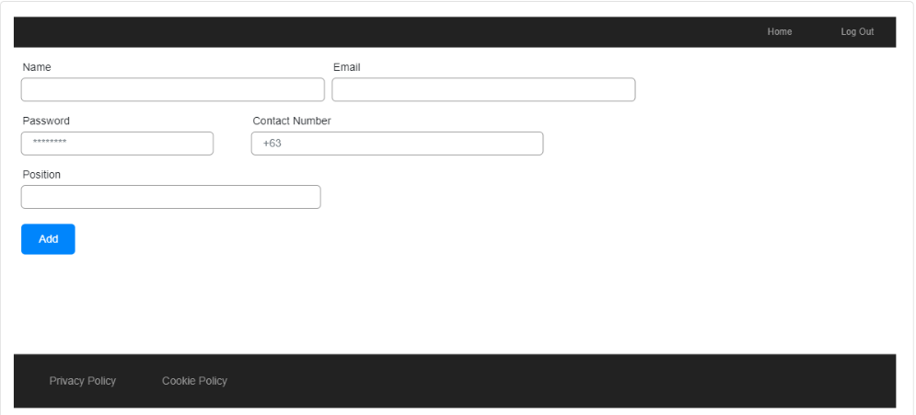
Wireframes

Slide 12
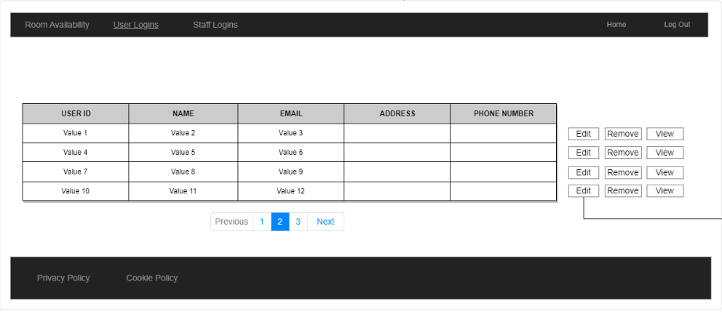
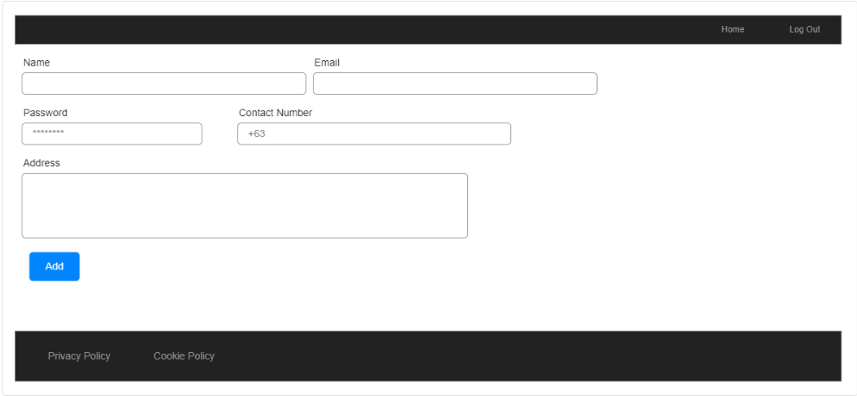
Wireframes

Slide 13
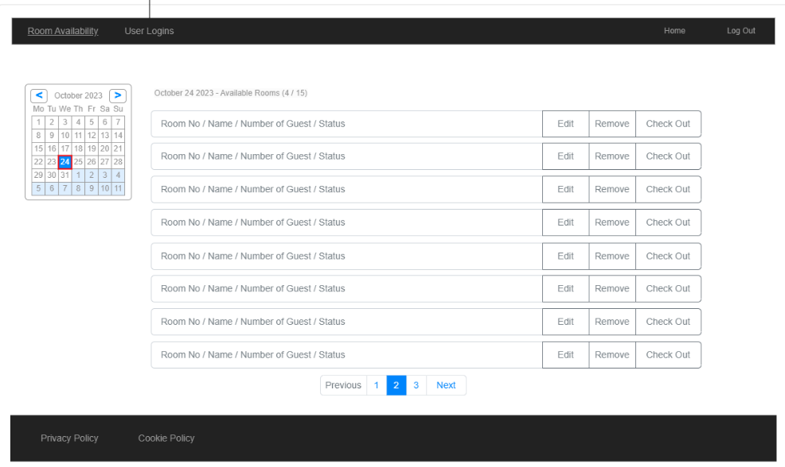
Wireframes

Slide 14


UML DIAGRAMS
Use Case Diagram
Sequence Diagrams
User
Staff
Admin
Class Diagram
www.collaberadigital.com

Slide 15
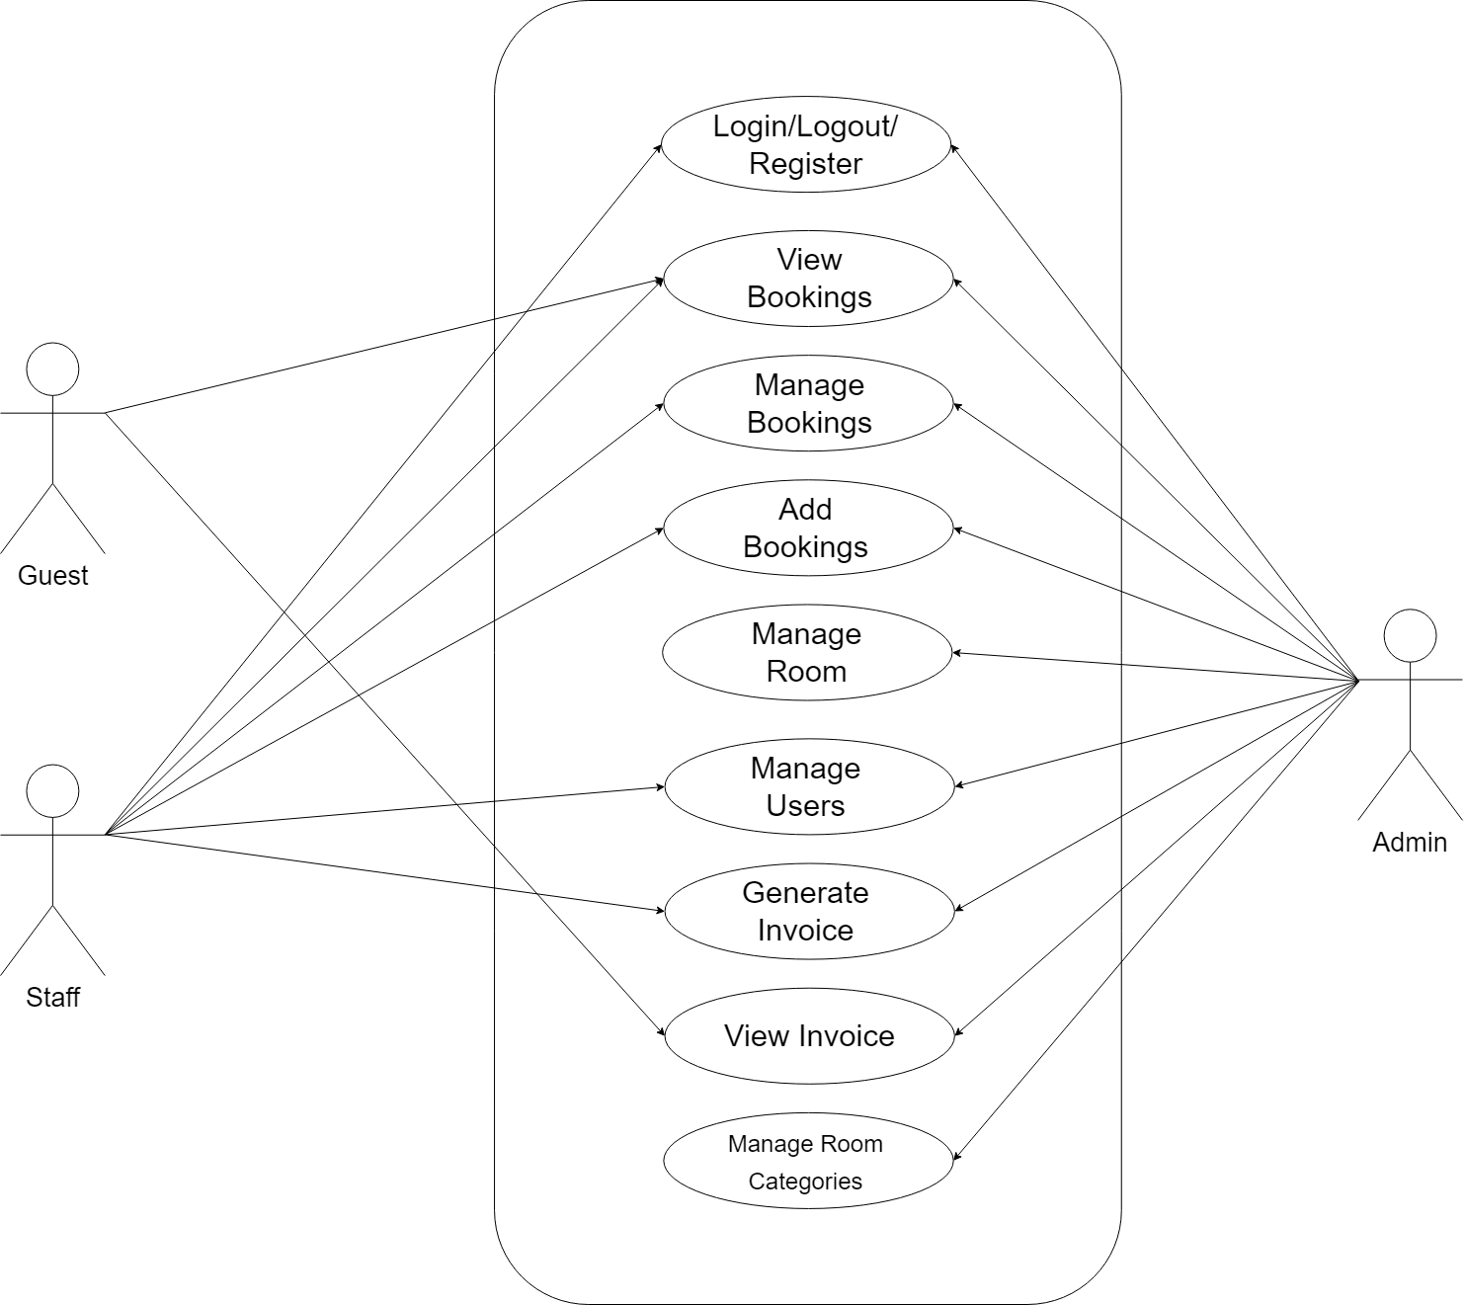
Use Case Diagram

Slide 16
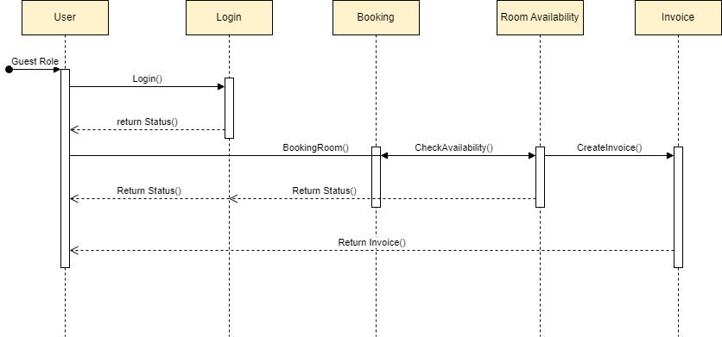
Sequence Diagram User

Slide 17
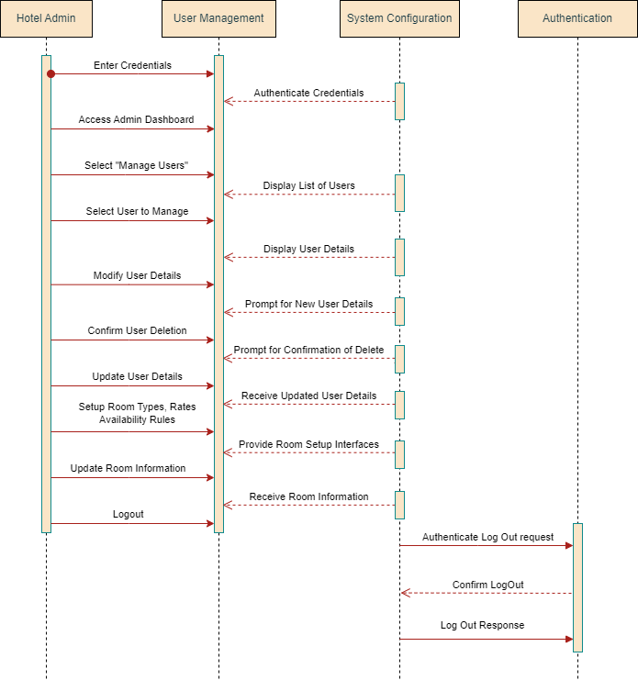
Sequence Diagram:
Admin

Slide 18
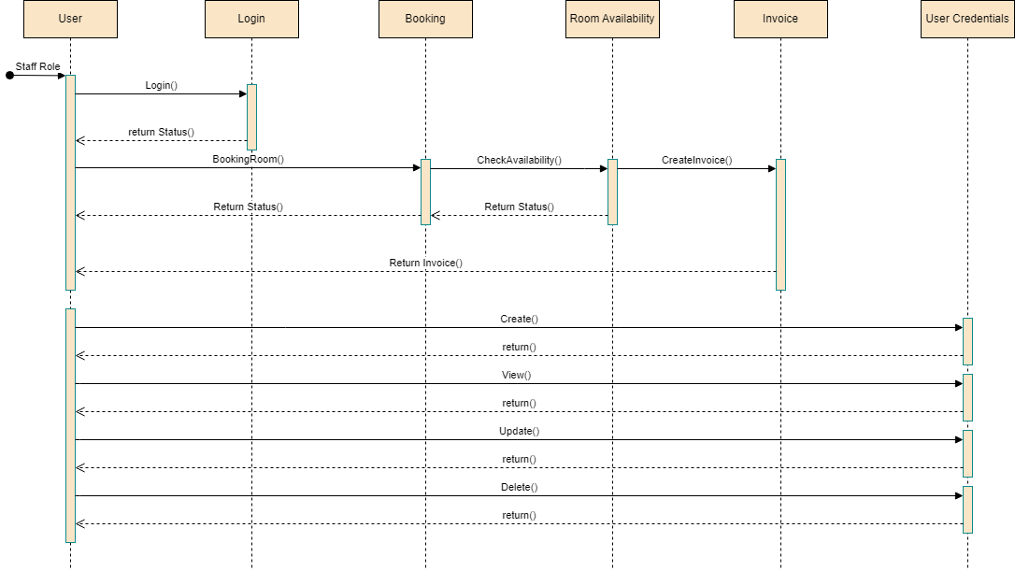
Sequence Diagram Staff

Slide 19
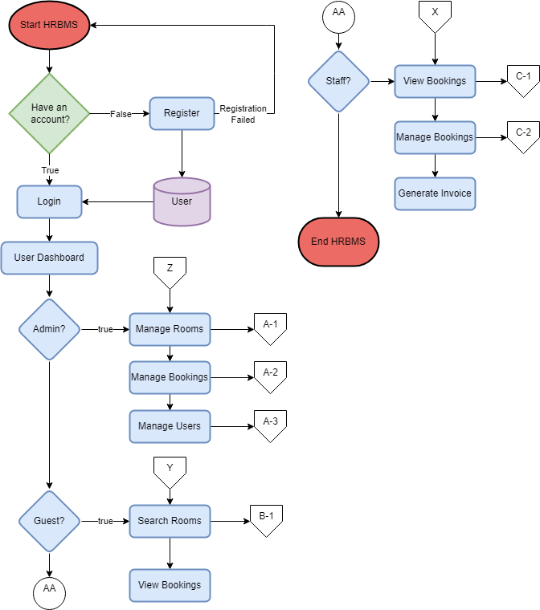
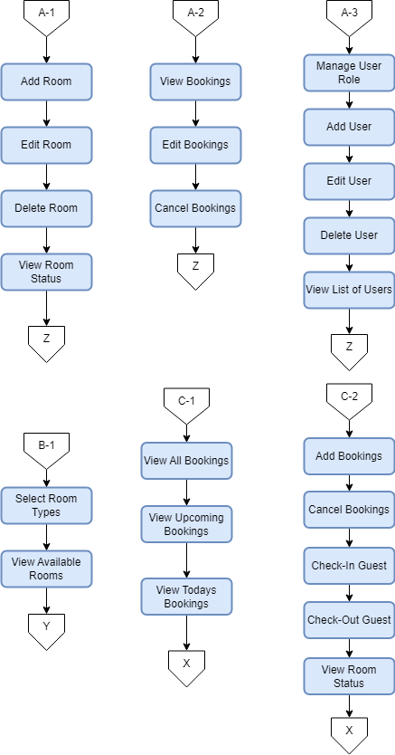
FlowChart

Slide 20
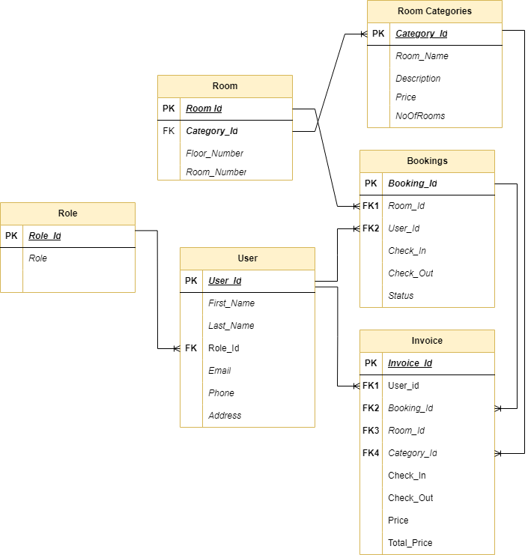
Entity-Relationship Diagram

Slide 21
Important areas of the Project with screenshots
(Frontend, Database, Backend, Key Validations, Functionalities Etc.)
www.collaberadigital.com

Slide 22
Important areas of the Project with screenshots
(Frontend, Database, Backend, Key Validations, Functionalities Etc.)

Slide 23
Important areas of the Project with screenshots
(Frontend, Database, Backend, Key Validations, Functionalities Etc.)

Slide 24
Important areas of the Project with screenshots
(Frontend, Database, Backend, Key Validations, Functionalities Etc.)

Slide 25
Conclusion

Slide 26
Thank You
www.collaberadigital.com

